Slide 1



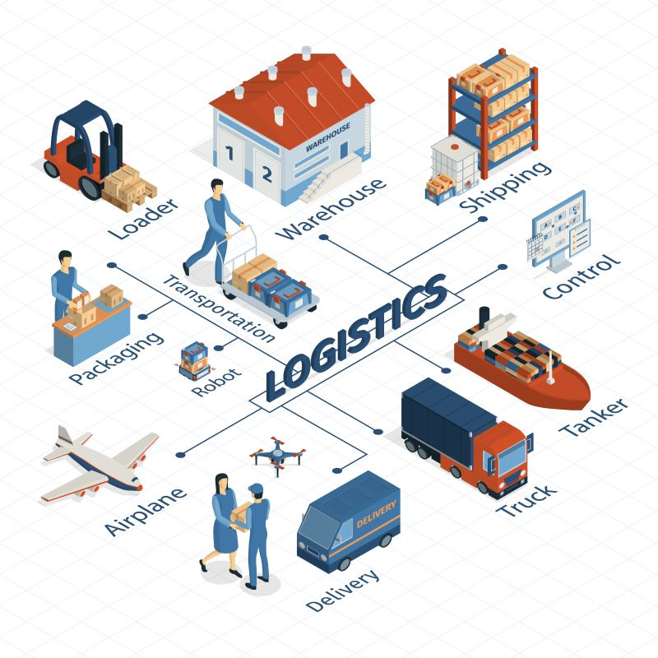


PRESENTATION 2026
Student Name
Student Email
Ishita Singhal
Singhalishita1011@gmail.com
Mentor Name
Abdul Aziz Md

Slide 2

Outline
01 Abstract
02 Problem Statement
03 Proposed Solution
04 System Architecture
05 Dashboard — Key KPIs
06 Dashboard — Regional Intelligence
07 Dashboard — Risk & Compliance
08 Conclusion
09 Future Scope

Slide 3

Abstract
Project domain: Power BI | Part of the AICW Fellowship Program by Edunet Foundation, Microsoft, LinkedIn & SAP.
Dataset: 2,263 cleaned order records × 48 fields covering Pacific Asia — Southeast Asia, Oceania, Eastern Asia & South Asia (Dec 2017 – Dec 2018).
Tool: Microsoft Power BI Desktop with DAX measures, custom visuals and features (Key Influencers, Smart Narrative, Decomposition Tree).
Output: 9-page interactive dashboard covering Executive KPIs, Regional Intelligence, Product & Category, Shipping & Delivery, Customer Analytics, Risk & Compliance, Root Cause, Order Detail, and Business Insights.
Total Revenue: $390,818 | Net Profit: $39,502 | Late Delivery Rate: 56.6% — insights drive operational decisions across the supply chain.

Slide 4

Problem Statement
56.6% Late Delivery Rate: Over 1,281 of 2,263 orders face delivery failure.
Shipping Mode Paradox: First Class shipping — the premium tier — has a 97.5% late delivery rate.
Regional Profit Imbalance: — signalling structural cost inefficiencies.
Discount-Driven Value Destruction: Men's Clothing shows a -17.9% avg. profit ratio; excessive discounting is generating orders at a net loss.
Fraud & Compliance Risk: 45 orders flagged as SUSPECTED_FRAUD and 48 CANCELED.

Slide 5
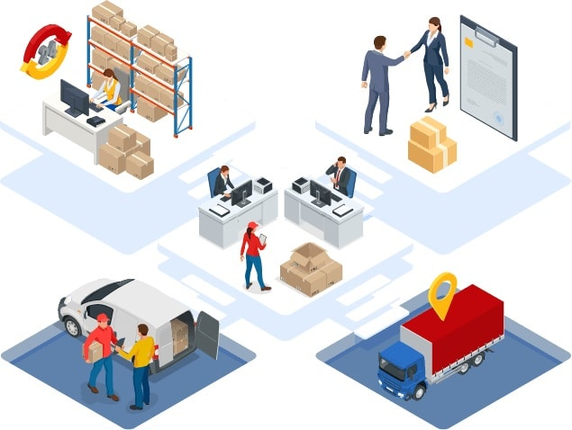
Proposed Solution
A 9-page interactive Power BI dashboard transforms raw Pacific Asia supply chain data into actionable business intelligence — enabling supply chain managers, logistics teams and executives to make evidence-based decisions.
Data Cleaning:
7 issue categories resolved — dates, discounts, nulls, types
DAX Measures:
20+ KPIs: Revenue, Profit, Late %, Fraud, Loss Impact
9-Page Dashboard:
Exec Summary → Regional → Product → Shipping → Customer → Risk → Root Cause → Detail → Insights
Special visuals
Key Influencers, smart Narrative & Decomposition Tree built in
Business Recommendations:
Shipping restructure, discount cap, regional strategy, fraud alerts

Slide 6




System Architecture
Data Input / Source
Pre-Processing
Pacific_Asia_CLEAN.xlsx — 2,263 rows × 48 cols. Orders_CLEAN sheet + Regional Intelligence lookup (GDP, Urbanization, Logistics scores for 20 region-country pairs).
Power Query for ETL validation. DAX Measures Table with 20+ calculations: Total Sales, Profit, Late Delivery %, Profit Ratio, Fraud Count, Loss Orders, Customer Count.
Analysis & AI -Tool Integration
Output / Dashboard
Power BI Key Influencers visual identifies First Class shipping as #1 late delivery driver. Smart Narrative auto-generates executive summaries. Decomposition Tree for root cause drill-down.
9-page interactive report with 80+ visuals: KPI cards, column/bar, donut, treemap, funnel, gauge, waterfall, scatter, ribbon, maps, pivot table, drill-through table.

Slide 7
Dashboard — Executive KPIs & Key Findings
Executive Summary Page · 9-Page Power BI Dashboard
$390.82K
$39.50k
57%
$172.70
Total sales
Net Profit
Late Delivery Rate
Avg Order Value
across 2,263 orders
10% overall margin
1,281 orders at risk
per order item

Slide 8
Dashboard — Regional Intelligence
Regional Intelligence Page · GDP, Logistics Score & Late Delivery Analysis
Region | GDP/Capita | Urbanisation | Logistics Score | Late Delivery % | Total Profit
Oceania | $55,000 | 0.81 | 3.8 | 56.2% | $13,260
Eastern Asia | $32,000 | 0.75 | 3.7 | 57.6% | $4,031
SE Asia | $7,000 | 0.55 | 2.8 | 57.5% | $12,607
South Asia | $6,000 | 0.36 | 2.5 | 54.9% | $9,603

Slide 9
Dashboard — Shipping, Risk & Business Insights
1,281
45
48
56.6%
97.5%
Late Deliveries
Suspected Fraud
Cancelled Orders
Overall Late Rate
1st Class Late Rate
Category | Avg Profit Ratio | Assessment
Consumer Electronics | 24.3% | Star performer
DVDs | 21.1% | Strong
Garden | 15.4% | Healthy
Women's Clothing | 14.9% | Good
Toys | 14.9% | Good
Music | 13.7% | Moderate
Health & Beauty | 11.3% | Below average
Men's Clothing | -17.9% | LOSS-MAKING — requires immediate attention

Slide 10
Live Demo of Project
Here's an overview of key dashboard pages and features:
Executive Summary
Regional Intelligence
Risk & Compliance
Monthly Revenue vs Profit trend, Order Status donut, Revenue by Department & Customer Segment KPI cards — total $390K revenue, $39.5K profit.
GDP vs Profit Ratio scatter, Late Delivery funnel, Sales ribbon chart & geographic map showing SE Asia & Oceania leading at $108K+ each.
KPI cards for fraud (45), cancellations (48), late deliveries (1,281). Waterfall chart quantifying profit loss. Discount-Profit scatter analysis.

Slide 11
Video of Project Demo
▶
My project demo video link is below.
https://drive.google.com/file/d/1VmDrhrvCXQ8f_ZxnENeDtQFg8Jr9vexO/view?usp=drive_link

Slide 12

Conclusion
This project successfully delivered a 9-page interactive Power BI dashboard for Pacific Asia supply chain analytics, achieving all six stated objectives.
Total revenue $390,819 | Net profit $39,502 | 10.1% margin across 2,263 orders.
56.6% late delivery rate — the most critical operational failure across all four regions.
First Class shipping paradox: 97.5% late delivery rate — worst performer despite premium pricing.
Oceania is most profitable ($13,260); Eastern Asia underperforms at only $4,031 profit.
Consumer Electronics leads profit ratio (24.3%); Men's Clothing destroys value at -17.9%.
All 6 project objectives achieved — data cleaned, 20+ DAX measures built, 9 dashboard pages delivered.

Slide 13

Future Scope
1
Real-Time Data Pipelines:
Integrate Power Automate or REST API connections for live dashboard refresh and real-time delivery alerts.
2
Predictive ML Models:
Apply Python/R integration in Power BI to forecast late delivery risk at order placement — using shipping mode, region & discount as inputs.
3
Expanded Geography:
Extend to broader APAC including North Asia, Central Asia and additional ASEAN markets for pan-regional intelligence.
4
Power Apps Interface:
Build a mobile Power Apps interface for frontline logistics staff to update order status and trigger compliance alerts directly.
5
Standardised DAX Library:
Package the measure framework as a reusable Power BI template deployable across other supply chain markets.

Slide 14
Thank You
AICW Fellowship | Student Project Presentation 2026
LinkedIn | Edunet Foundation

